Slide 1
About peter Vieveen
Peter Vieveen
20 years in construction - roads, sewers, bridges
Founder and Chairman –north America traffic Inc.
2019 – celebrating 25 years
Invented the first AFAD in 1994

Slide 2
talking points for today
What is an afad?
How / when / where?
NIOSHA Video on avoiding flagger fatalities
AFAD facts
Return on investment
Notes:
Today we are going to learn about what an AFAD is;
How, When and Where AFADs are used;
NIOSHA Video on Avoiding Flagger Fatalities
facts about AFADs and ROI.

Slide 3
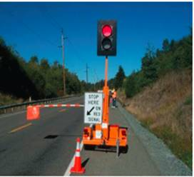
what is an afad?
A remote controlled device that is;
That allows a flagger to control traffic from a safe location
Effective at controlling traffic
Adequate to warn, direct, and regulate traffic
* Can Be Used for Short and long-term flagging operations

Slide 4
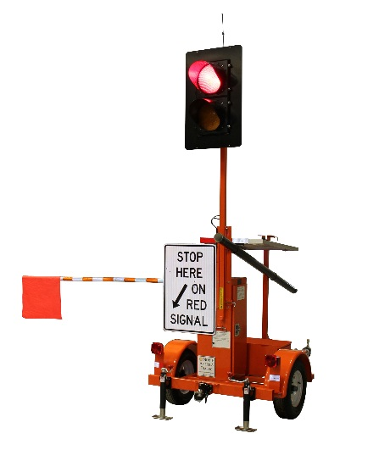
key Features
Highly visible 12” red light
12” amber light - caution
10’ gate-arm - barrier
Wireless remote control - safety
Notes:
Important features –
A highly visible12” Red stop light – Can be seen from a long way in advance of the work zone
12” flashing amber light – indicating to proceed with caution
A 10 foot gate-arm – provides a physical safety barrier to prevent motorists from entering the work zone
And most important….it is remote controlled by a flagger from a safe location.

Slide 5
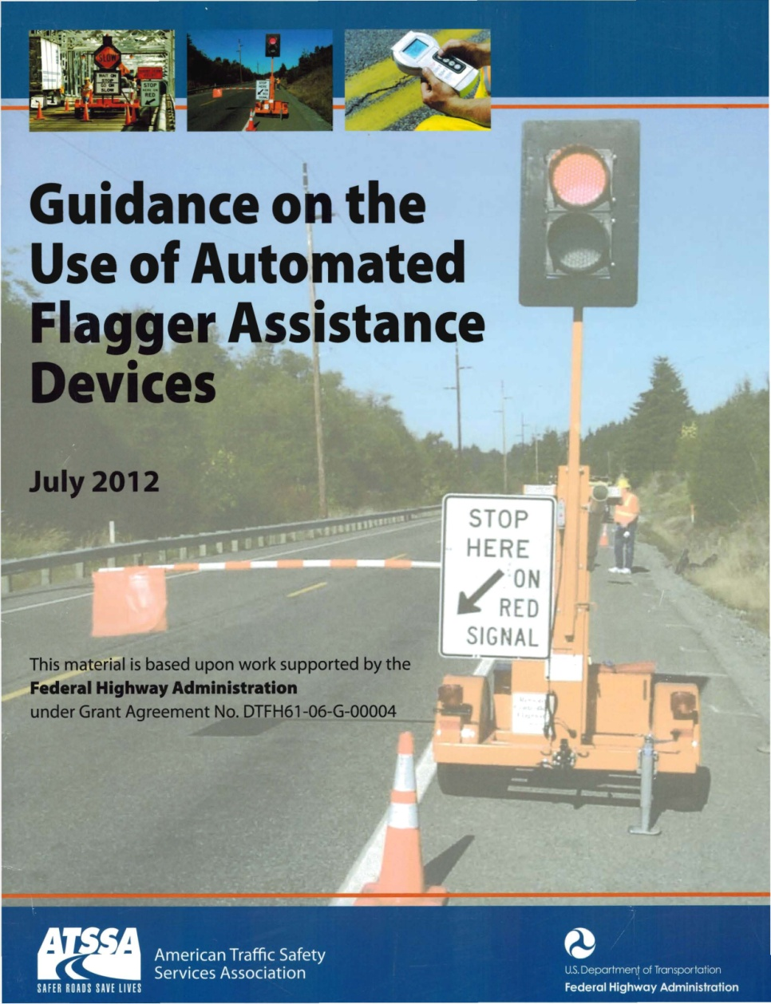
AFAD approval
2004 - FHWA approved under Interim Approval guidelines
2009 - MUTCD
2012 - ATSSA publication (pictured)
Notes:
AFADs were first approved in 2004 under the interim approval guidelines of the MUTCD
In 2009 a new AFAD category written into the Manual - Automated Flagger Assistance Devices
In 2012 - ATSSA Publication - Guidance on the use of AFADs. A Red/Yellow lens AFAD shown here on the Front page of the

Slide 6
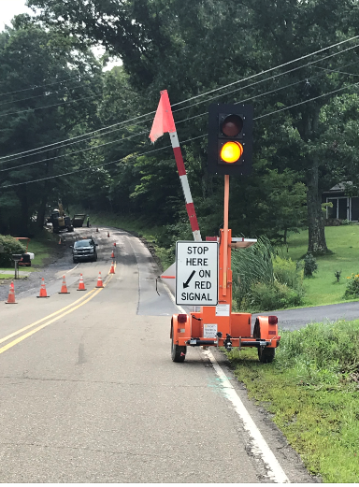
AFAD operating methods
1 Flag person + 2 afads @ 800ft
2 Flag persons + 2 afads @ 5,000ft
Notes:
AFADs can only be used on a two-lane roadway with two-way traffic in a single lane.
One flag person operating two AFADs, 800 feet apart with a clear line of sight.
Two flaggers and two AFADs, as if they were using a stop/slow paddle, up to 5,000 feet apart.

Slide 7
National Institute of Occupational Safety and Health
When to use afad’s
“Avoid using flaggers whenever possible.”
“Use alternative management systems such as lane shifts, portable Traffic signals, or remote signaling devices operated by workers away from the flow of traffic.”
Notes:
In a publication by… their recommendations are;

Slide 8
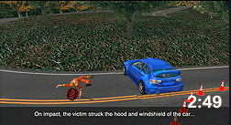
NIOSHA
Fatality Assessment and control evaluation video (FACE)
“Avoiding Flagger Fatalities”
Notes:
Taken from the work zone safety.org website

Slide 9
flagger fatalities continue to rise
32 fatalities in 2003 to 2010, an average of 4.0 annually,
30 fatalities in 2011 to 2017, an average of 4.3 annually.
Any such tragedies, much less an upward trend, are unacceptable.
Notes:
The statistics confirm that there are conditions where a flagger should not be utilizing a Stop/Slow paddle.

Slide 10
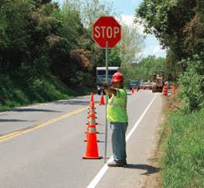
A task force is needed
Recommendations for “Suggested Priorities on the application of AFADs”
a numerical ranking, assigned to the use of AFADs, will assist engineers to improve traffic safety and to reduce the number of flagger fatalities.

Slide 11
risky drivers
Risky drivers are the major cause of flagger fatalities
distracted, speeding, drunk, drug impaired and drowsy drivers.
High-visibility apparel is not a feasible means to protect flaggers exposed to risky drivers
Flaggers deserve a safe working environment
Injury and death is preventable

Slide 12
afad facts
Can be operated by people with disabilities, creating new job opportunities for them
Can be operated by a worker assigned to light duty work
Can be equipped with an intrusion alarm

Slide 13
AFAD facts
A flagger seldom suffers from fatigue or stress during the day, reducing flagger errors
There are few restrictions as to where an AFAD can be utilized, when operated as a stop/slow paddle

Slide 14
$1.00 - $2.00 / hr.
ANNUAL COST OF OWNERSHIP
Notes:
Here are details on the annual cost of ownership… for one machine

Slide 15
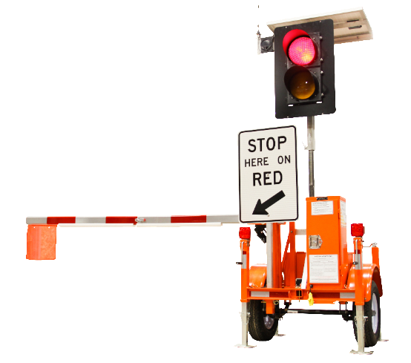
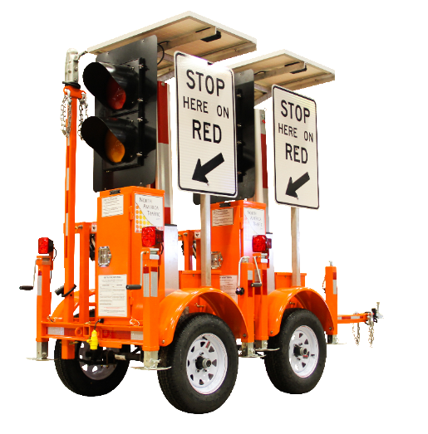
the industry is changing
flaggers prefer using AFADs over stop/slow paddles
2019 AFAD - two units locked - one trailer

Slide 16
Questions?
Peter Vieveen
North America Traffic Inc.
peter@NorthAmericaTraffic.com
905-984-7558
www.NorthAmericaTraffic.com

